Slide 1
PROJECT TITLE
CAPSTONE PROJECT
Presented By
NAME: VASAMSETTI SATYASAHITHI
COLLEGE NAME: BONAM VENKATA CHLAMAYYA ENGINEERING COLLEGE
DEPARTMENT NAME :CSE
AICTE ID:STU662890e45ff341713934564

Slide 2
OUTLINE
Problem Statement (Should not include solution)
System Development Approach (Technology Used)
Algorithm & Deployment (Step by Step Procedure)
Result
Conclusion
Future Scope(Optional)
References

Slide 3
Problem Statement
Students often face challenges in organizing study schedules and tracking academic tasks. This planner helps users create, view, and manage study goals with reminders and visual timelines. The goal is to boost productivit and time management. Tasks and progress can be saved locally.

Slide 4
System Approach
The Smart Study Planner is implemented as a Single-Page Application (SPA) using a client-side approach, focusing on ease of access and a responsive user experience.
Frontend Technologies:
- HTML5 – Provides the structure for the planner.
- CSS3 – Handles styling with modern interface features.
- JavaScrip – Manages interactivity and reminder functionality.
- Data Storage: Browser Local Storage is used to persist tasks across sessions.
Design Approach:
- Clean and user-friendly interface.
- Mobile-responsive design (Goal).
- Modular separation of HTML, CSS, and JS files for maintainability.

Slide 5
Algorithm & Deployment
                Product Catalog Creation
Task Management Algorithm:
1. Task Capture: User input captured on form submission.
2. Local Storage: Tasks saved with JSON.stringify().
3. Progress Calculation: Dynamic progress % calculation.
4. Rendering: Tasks displayed with progress bars.
5. Reminder Logic: Alerts trigger 24 hours before deadline.
6. Deletion: Tasks removable from list and Local Storage.
Deployment: Static files (HTML, CSS, JS) hosted using GitHub Pages or Netlify

Slide 6
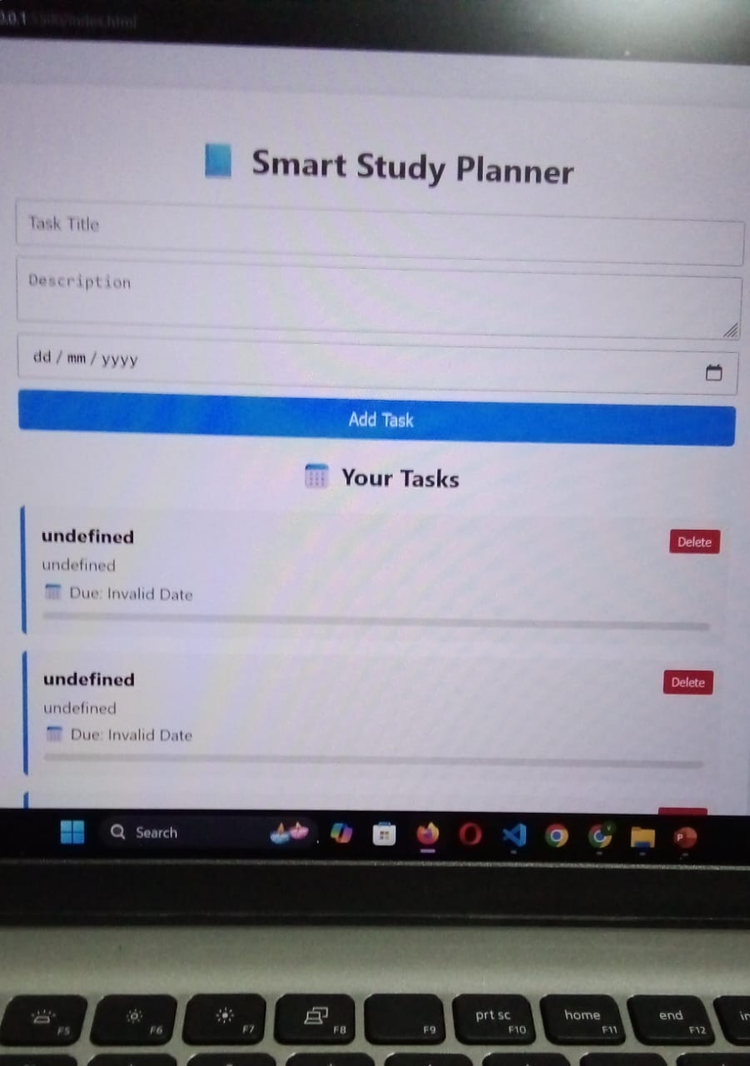
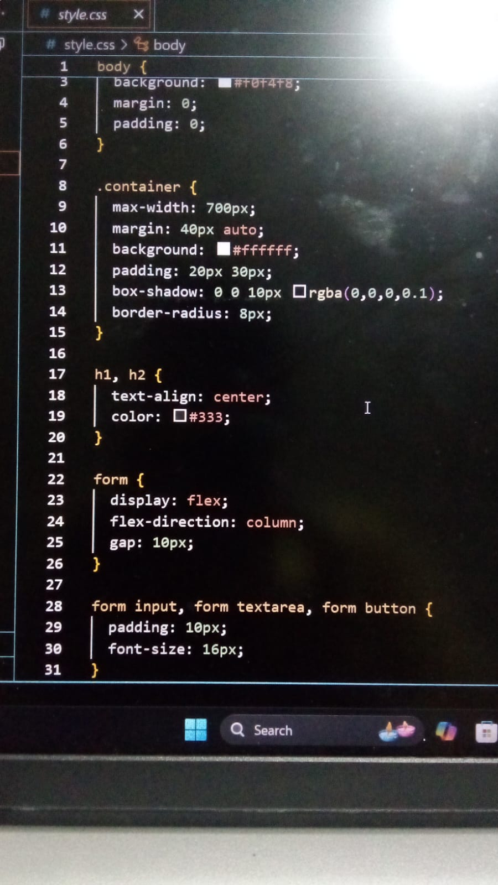
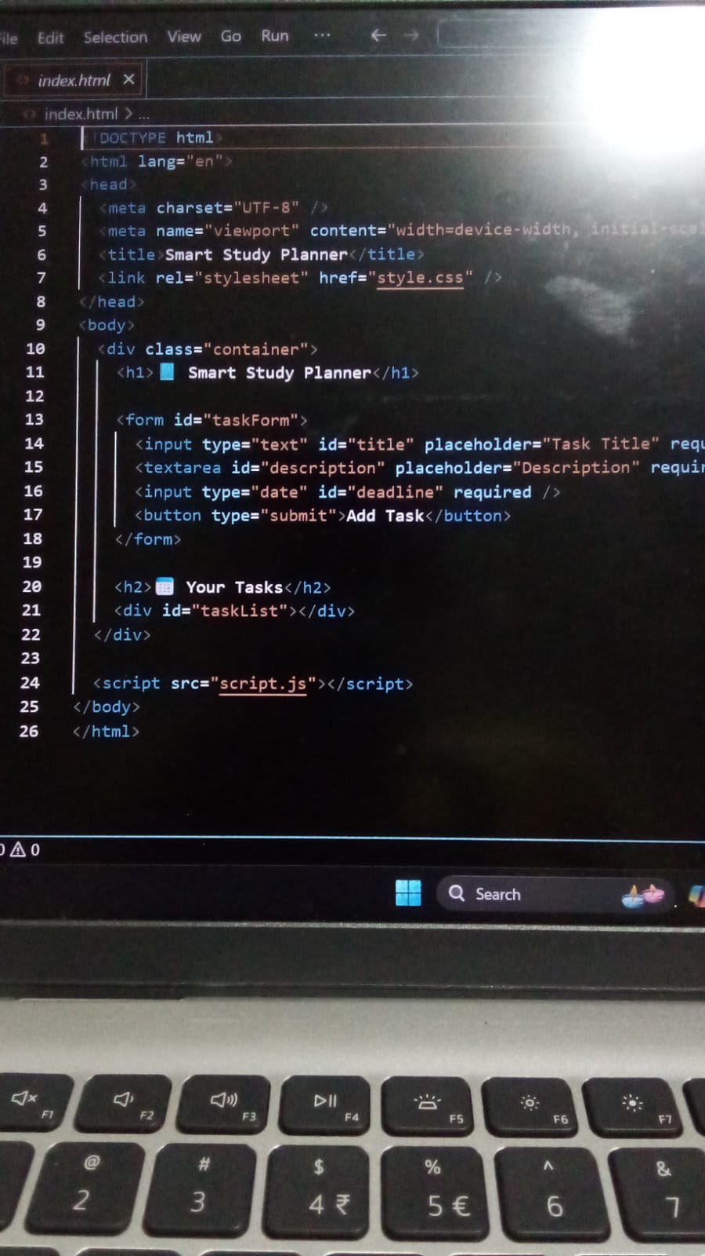
Result

Slide 7
GITHUB AND DEPLOYMNET LINK
Attach your Github Link : https://github.com/satyasahithi07/study-planner
Deployment link: https://github.com/satyasahithi07/study-planner

Slide 8
Conclusion
The Smart Study Planner provides a cost-effective and accessible solution for managing academic tasks.
Improves time management with visual task tracking. - Lightweight client-side implementation.
- Automated reminders improve study discipline.
                .

Slide 9
References
List and cite relevant sources, research papers, and articles that were instrumental in developing the proposed solution.
NanthiniMoha/TNSDC-FWD-DIGITAL_PORTFOLIO
Get started with Bootstrap · Bootstrap v5.3

Slide 10
THANK YOU

